Slide 1
Group Chat Analysis
Team ID: 11
Project Advisor:
Ms.Kavitha C. R./Department of Computer Science
S.No | Reg.No | Name of the Student | Section
1 | BL.EN.U4CSE19064 | K Aditya Rohith | CSE A
2 | BL.EN.U4CSE19103 | P. Jaswanth Sai Reddy | CSE A
3 | BL.EN.U4CSE19008 | A.V.N.Rambabu | CSE A
4 | BL.EN.U4CSE19046 | G. Bala Nagendra Babu | CSE A

Slide 2
Introduction
These days, the use of social media networks now have become a commonplace mode of data sharing.
People using social media for personal purpose and also used for the professional purpose as sharing or advertising the business-related details etc.
For the privacy and safety of the users the data is encrypted.
We analyze the model and we can conclude whether the chat we are going safe and going correctly or not and also we can get the review of the group chat.

Slide 3
Motivation
This Group Chat Analysis work is intended to perform an activity analysis and time analysis.
This analysis has many use instances just like the parent, who wants to analyze their child chat, the police , who need to get valuable data from culprit chat , and the business people, who wants to understand the status of the business in the group chat.
This enables to find the state of mind of the users. Further, this analysis work calculates the number of positive and negative statements which are used by everybody within the group chat.

Slide 4
Contd…
The motivation for this group chat analysis goes deep as we can retrieve the following information .
Number of messages per user.
Number of words per user.
Number of average words per message per user.
Number of Media per user.
Number of messages per hour, week, month.

Slide 5
Problem Definition
To design a group chat analyzer that ensures safety of data and for best understanding of information

Slide 6
Literature Survey
S.NO | Name of the author | Full title of the paper | Inference of the paper | Open problem
1 | Ravishankar , Dhanush | Whatsapp Chat Analyzer | FDS technologies | Group chat anlysis
2 | Atul Singh | Research paper on Group chatting Application | Robust index system usingdistributed hash table | Group chat anlysis
3 | Ali, Rizvi & Sherdil | n analytical study to evaluate the Effectiveness of WhatsApp Application | Sentiment analyzer | Group chat anlysis

Slide 7
Gaps and Challenges
Difficult to classify the data based on the date , message , author.
Sentiment Analysis

Slide 8
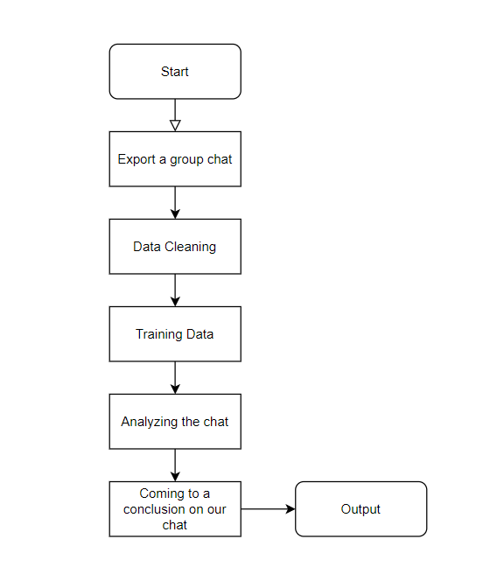
System Design

Slide 9
Data Set
Group Chat Analysis need an chat file , So we have taken a WhatsApp group chat of our own group.

Slide 10
System Specifications
An OS that supports python
System with 8GB RAM
Recent processors

Slide 11
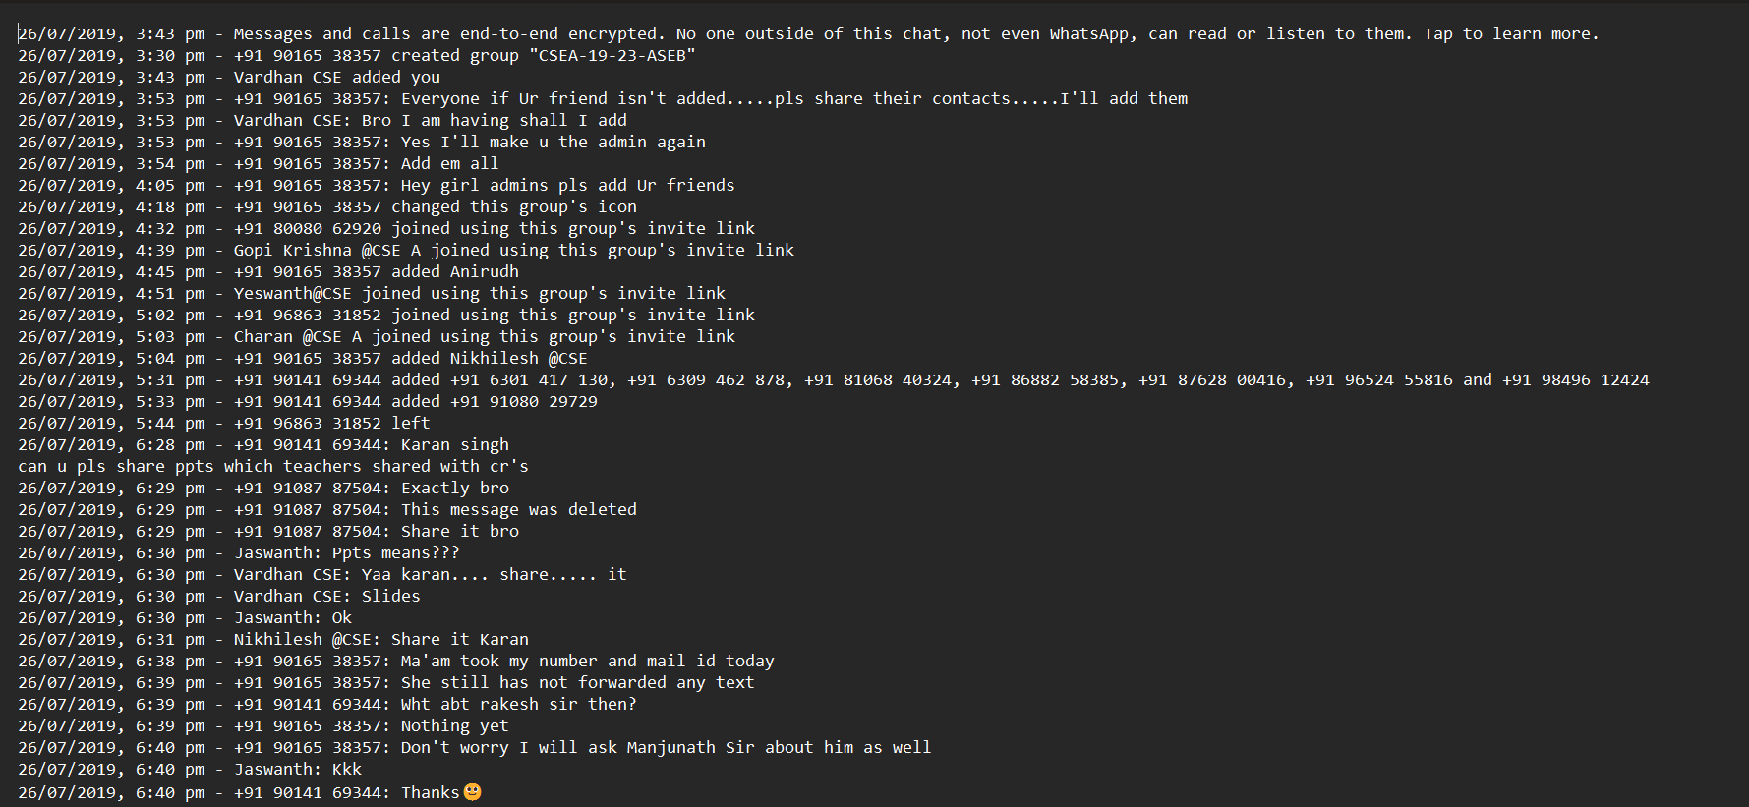
Sample Data Set

Slide 12
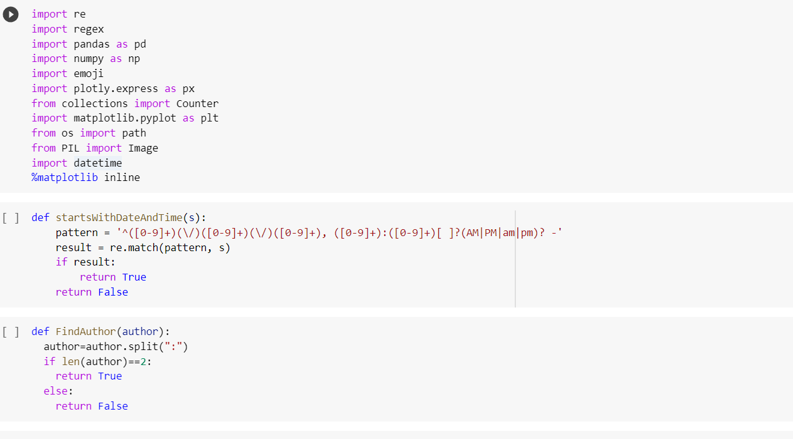
System Implementation

Slide 13
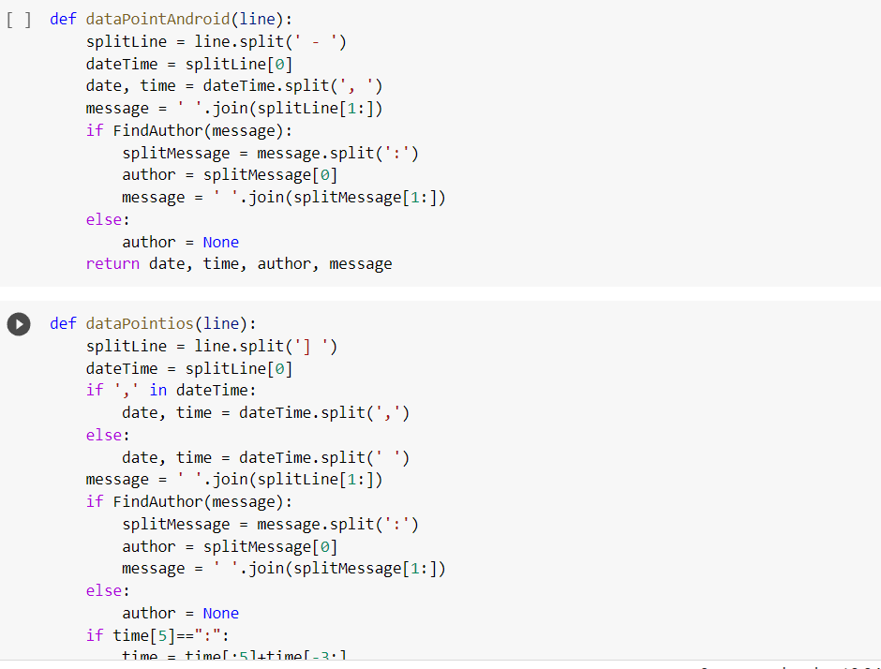
System Implementation

Slide 14
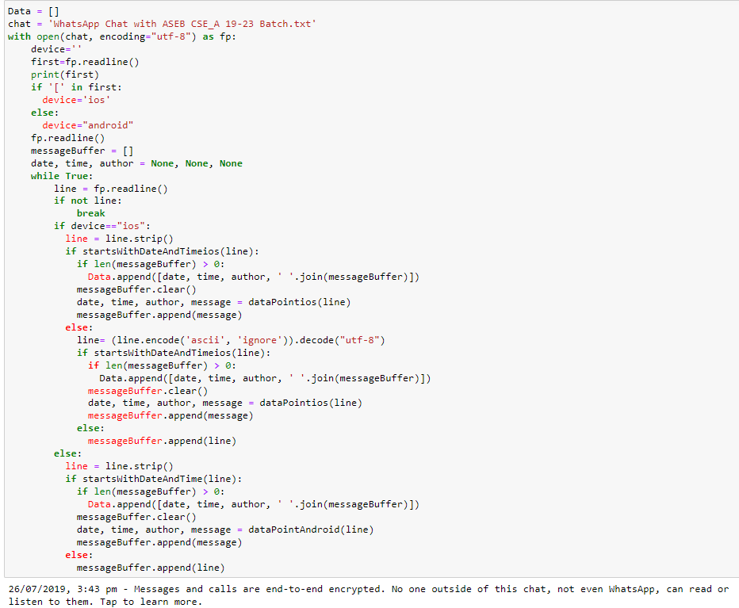
System Implementation

Slide 15
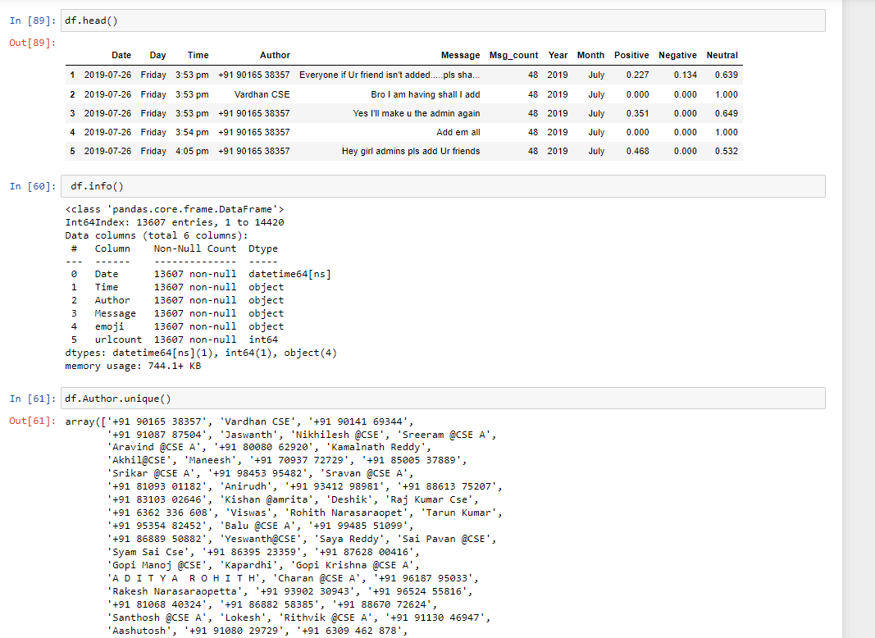
System Implementation

Slide 16
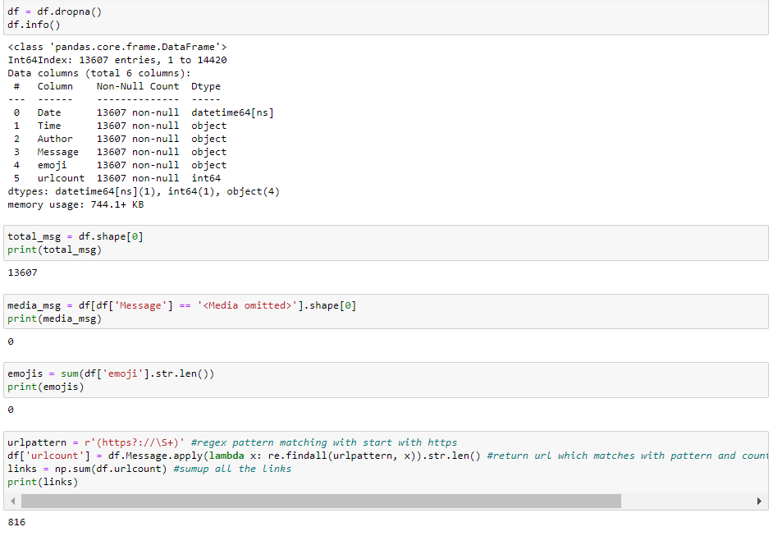
System Testing

Slide 17
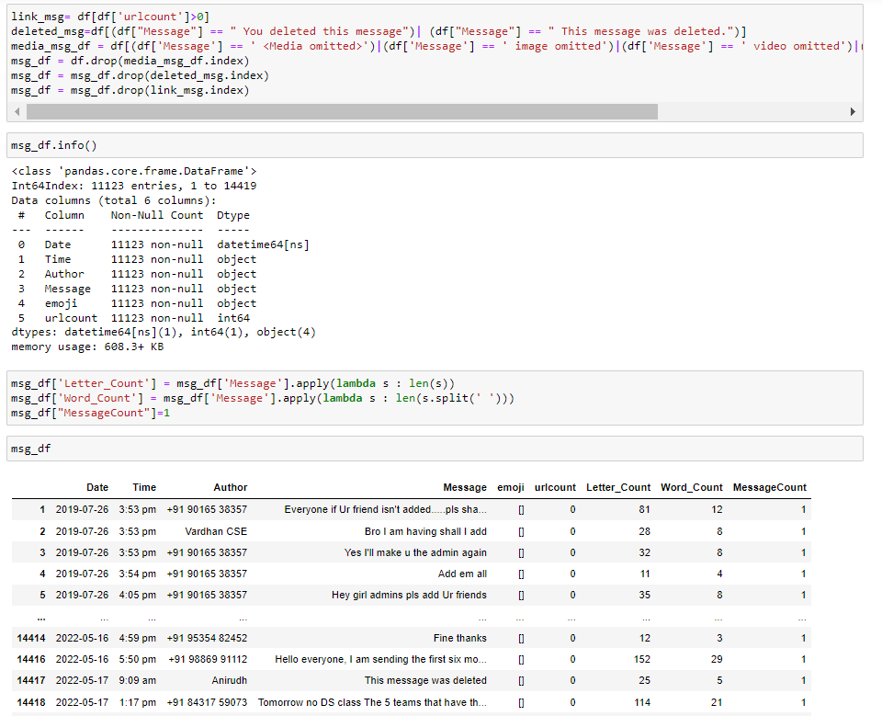
System Testing

Slide 18
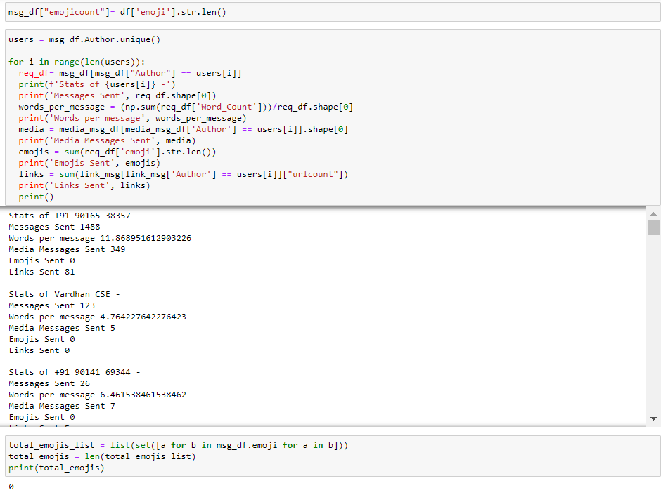
System Testing

Slide 19
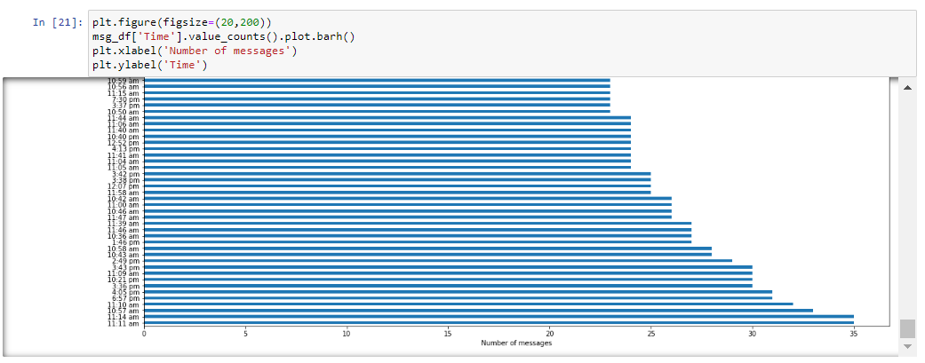
Results and Analysis

Slide 20
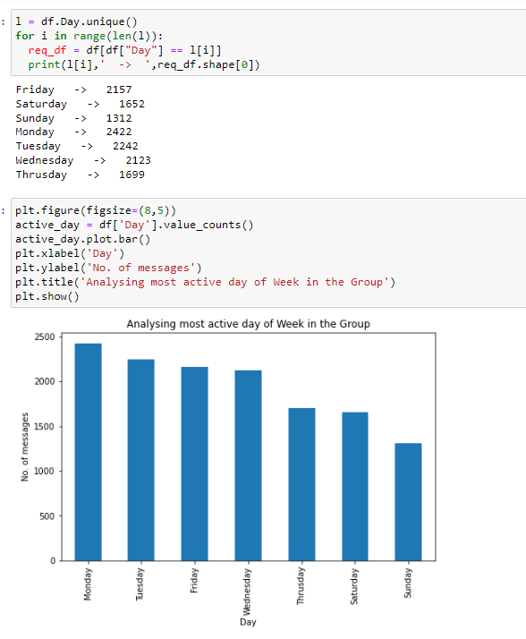
Results and Analysis

Slide 21
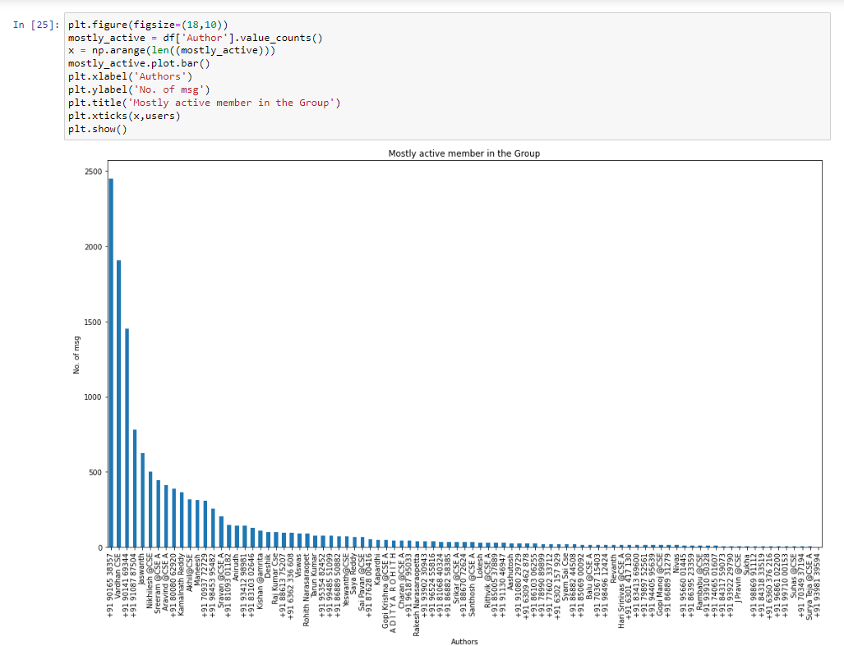
Result and Analysis

Slide 22
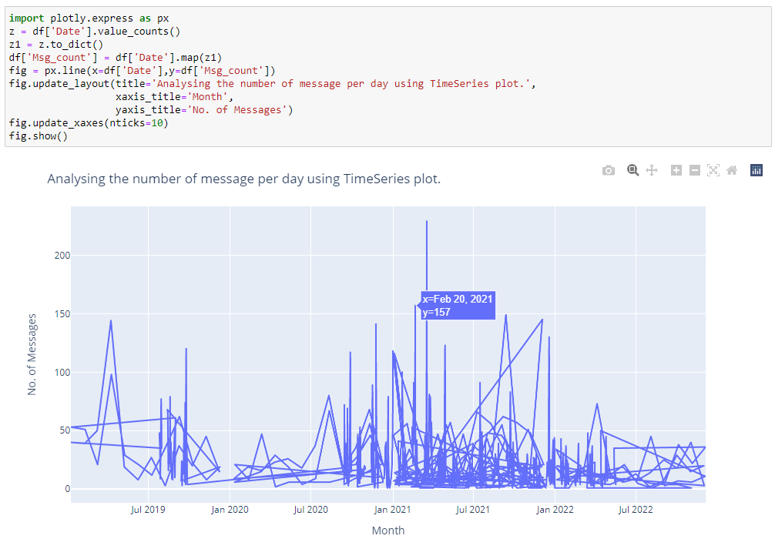
Result and Analysis

Slide 23
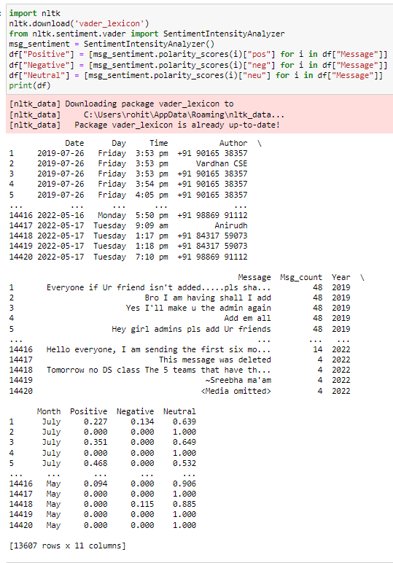
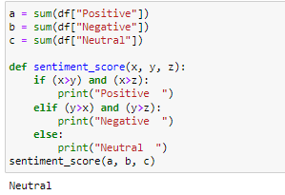
Conclusion

Slide 24
Conclusion
This work was able to discuss the WhatsApp application and its libraries, to create an analysis of a WhatsApp group chat and visually represent the top 10 and top 20 users in the chat groups.
A pseudocode of the plot was given and at the end, visual representation of the plot was implemented.

Slide 25
Timeline
Literature Survey
Design [Front End, Back End]
Implementation
Testing
Document Submission
<24/04/2022>
<06/05/2022>
<09/05/2022>
<12/05/2022>
<16/05/2022>
Abstract Submission
<10/04/2022>

Slide 26
THANK YOU

Slide 27
References
https://www.ijeat.org/wpcontent/uploads/papers/v9i5/E9578069520.pdf
http://indusedu.org/pdfs/IJREISS/IJREISS_3661_55346.pd

